Slide 1


Slide 2

Presentation For Mini Project - II “Exploratory Data Analysis of the American Retail Market”
Presented By :
Bhushan Haridas Ukarande
Sahil Suresh Patil
Amreshwar Sunil Mahimkar
PRN No:
2263151242052
2263151242054
2263151242040
Under the guidance of Prof. S. J. Vibhute.
Department of Computer Science and Engineering Sanjeevan Group Of Institute,Panhala
2024-2025

Slide 3
Introduction
• Retail industry is a backbone of the U.S. economy.
• Companies collect large volumes of sales, inventory, and customer data.
• EDA helps uncover trends and optimize decisions.

Slide 4
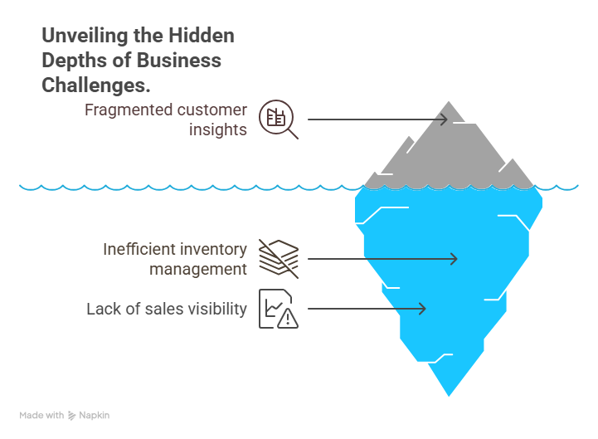
Problem Statement
Analyze retail sales data across the U.S. to uncover regional trends, identify high-performing markets, and understand seasonal impacts.

Slide 5
Objectives
• Clean and prepare historical retail data.
• Visualize performance by region, category, and customer segment.
• Identify trends and potential improvement areas.
• Support strategic decisions with data-driven insights.

Slide 6
Literature Survey
Title: Retail Data Analytics - Smith et al. (2019)
- Emphasized importance of real-time analytics.
Title: Consumer Segmentation in Retail - Johnson & Lee (2021)
- Segmentation improves targeting and ROI.
Title: Visualization for Big Data - Gupta (2020)
- Visual tools critical for insight delivery.

Slide 7
Proposed Methodology
• Tools: Python, Pandas, Matplotlib, Seaborn.
• Steps:
1. Data Cleaning
2. Descriptive Statistics
3. Visual Exploration
• Focus: Patterns in sales, profit, discount, geography.

Slide 8
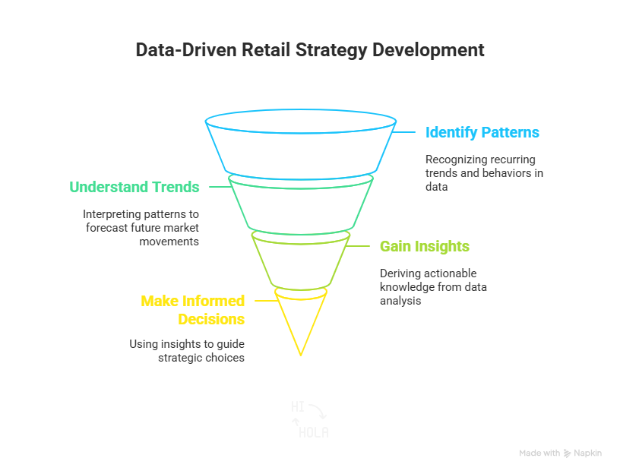
System Architecture / Workflow
•Input: Retail Dataset (.csv)
•Process:
- Data Preprocessing
- Analysis using Python libraries
•Output: Visual reports (bar charts, heatmaps, etc.)

Slide 9
Implementation
• Environment: Jupyter Notebook
• Code handles:
- Missing values, outliers
- Category-wise grouping
- Region/state-based analysis
• Charts plotted for top-performing products, sales trends.

Slide 10
Testing & Results
• Cart & segmentation logic tested.
• Data summaries verified manually.
• Insights:
- High Q4 sales trend.
- Office Supplies: top selling category.
- States like California & New York show high profits.

Slide 11
Advantages & Limitations
Advantages:
- Uses open-source tools.
- Scalable to larger datasets.
Limitations:
-Only historical analysis.
- No predictive insights.

Slide 12
Future Scope
• Integrate predictive analytics using ML.
• Real-time dashboards with Tableau/Power BI.
• Incorporate customer segmentation and behavior analysis.
• Add real-time APIs for live data tracking.

Slide 13
Conclusion
• EDA helps derive actionable insights from retail data.
• Supports smarter decisions in inventory, marketing, and sales.
• Foundation for future data-driven strategies.

Slide 14
References
• [ 1 ]. McKinney, W. (2021). Python for Data Analysis
(2nd ed.). O’Reilly Media.
[ 2 ]. Wickham, H., & Grolemund, G. (2016). R for
Data Science: Import, Transform Visualizeand
Model Data. O'Reilly Media.
[ 3 ]. McKinney, W. (2017). Python for Data Analysis:
Data Wrangling with Pandas, NumPy, and
Python (2nd ed.). O'Reilly Media.
[ 4 ]. Han, J., Kamber, M., & Pei, J. (2011). Data
mining: Concepts and techniques (3rd ed.). Morgan
Kaufmann.

